Slide 1
Session 6: Lower Bound of Sorting, Bucket Sort

Slide 2
Agenda
Lower Bound of Sorting
Bucket Sort
Summary

Slide 3
Lower bound on runtime of comparison sorts
Merge sort and heapsort run in worst-case O(n log n) time, and quicksort runs in expected O(n log n) time.
One wonders if there's something special about O(n log n) that causes no sorting algorithm to surpass it.
As a matter of fact, there is! We can prove that any comparison-based sorting algorithm must run in at least (n log n) time.
Comparison-based means that the algorithm makes all its decisions based on how the elements of the input array compare to each other, and not on their actual values.

Slide 4
Decision trees
Given an unsorted array, the algorithm must decide how to permute the array to produce sorted output. Because there are n! possible orderings of an array with n elements, a comparison based sorting algorithm may be asked to do n! different things.
The decisions must be based on comparisons, which each provide 1 bit of information.
To accommodate n! possible outcomes, we need at least log(n!) bits of information, which as we will see, is roughly n log n.

Slide 5
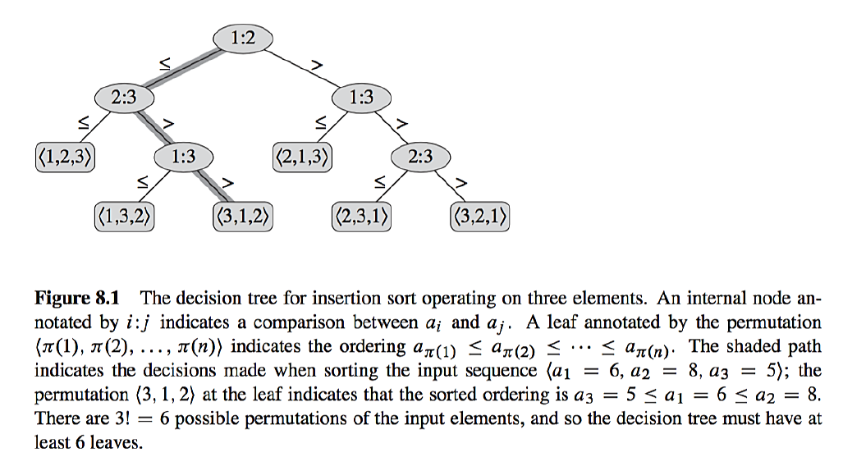
Decision trees…
6:8
8:5
6:5
5,6,8

Slide 6
Lower bound
Now in order for a comparison sort to be correct, the leaves of the decision tree must contain all possible permutations of the input array.
This is because the input can be in any possible order, so the algorithm must be able to output all possible rankings of the input elements.
There are n! permutations of the input array, so the decision tree must have at least n! leaves. Therefore, the height of the decision tree must be (log(n!)).
The height of a binary tree with m leaves is (log m)

Slide 7
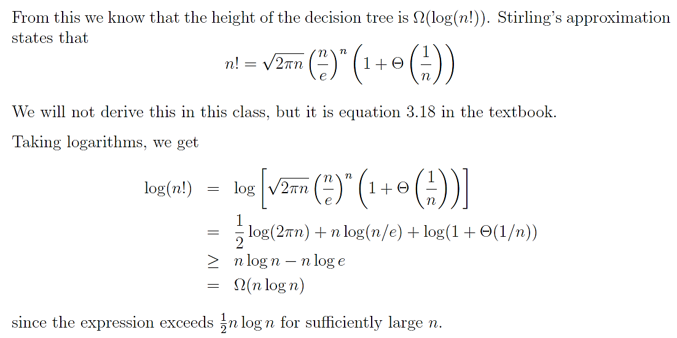
Stirling's approximation

Slide 8
Bucket Sort
Bucket sort, or bin sort, is a sorting algorithm that works by partitioning an array into a finite number of buckets.
Each bucket is then sorted individually, either using a different sorting algorithm, or by recursively applying the bucket sorting algorithm.
The idea behind bucket sort is that if we know the range of our elements to be sorted, we can set up buckets for each possible element, and just toss elements into their corresponding buckets.
We then empty the buckets in order, and the result is a sorted list.

Slide 9
Example 1
Consider sorting the following set of 10 unique integers in the range 0..15. That is, max = 15.
Create a bit-vector with 15 buckets. For each number, set the bit of the corresponding bucket to 1. After carrying out this step, the bucket bit vector will look like the following: bucket[0..15]
Now, just traverse the list and record only those numbers for which the bit is 1 (true). That is, we automatically get the sorted list,
1 4 5 7 8 9 10 11 12 15
0 | 1 | 2 | 3 | 4 | 5 | 6 | 7 | 8 | 9
10 | 1 | 11 | 8 | 9 | 15 | 12 | 5 | 7 | 4
0 | 1 | 2 | 3 | 4 | 5 | 6 | 7 | 8 | 9 | 10 | 11 | 12 | 13 | 14 | 15
0 | 1 | 0 | 0 | 1 | 1 | 0 | 1 | 1 | 1 | 1 | 1 | 1 | 0 | 0 | 1

Slide 10
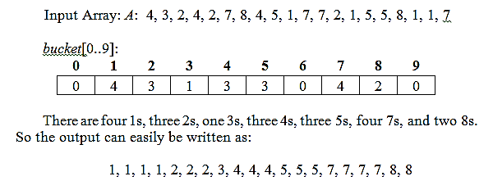
Example 2

Slide 11
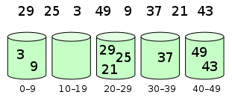
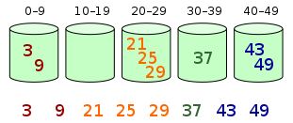
Variation (Reducing No. of Buckets)

Slide 12
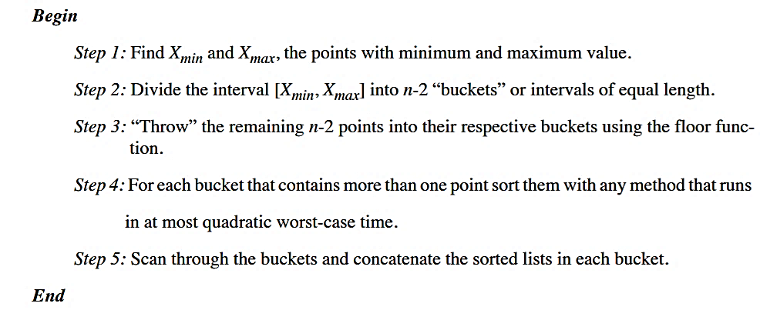
Pseudo Code

Slide 13
Bucket Sort Algorithm
Algorithm BucketSort(A[0..n-1], n)
// Input: Unsorted Array, A
// Output: Sorted Array in A[0, n-1]
for i = 0 to n-1 do
B[A[i]] = B[A[i]] + 1
j = 0
for i = 0 to MAX-1 do
if B[i] != 0
for k = 0 to B[i] – 1 do
A[j] = i
j = j + 1
return.
A
0 | 1 | 2 | 3 | 4 | 5 | 6 | 7 | 8 | 9
10 | 1 | 11 | 8 | 9 | 15 | 12 | 5 | 7 | 4
B
0 | 1 | 2 | 3 | 4 | 5 | 6 | 7 | 8 | 9 | 10 | 11 | 12 | 13 | 14 | 15
0 | 1 | 0 | 0 | 1 | 1 | 0 | 1 | 1 | 1 | 1 | 1 | 1 | 0 | 0 | 1

Slide 14
Analysis
The worst-case scenario occurs when all the elements are placed in a single bucket.
The overall performance would then be dominated by the algorithm used to sort each bucket, which is typically O(n²) using insertion sort.
If we use Quicksort, the complexity is O(n log n).
Average time complexity – O(n)

Slide 15
Summary

